Slide 1
We Are Ready
Emergency Response Done Right

Slide 2
Problem Statement
WHAT
Most of the times, Emergency response activities poses series of problems like identifying of people in distress, how many people are to be rescued where they are, etc.
WHERE
Point in case, Chardham yatra last year. Many people were stranded, many bodies unidentified, people are not aware of their relatives on yatra.

Slide 3
Solution Covers
HOW
This solution helps the government authorities, rescue helpers, medical units to address simple questions like
How many people stuck between 2 places (Checkpoints)
How many are of what age group
Who are the people who are rescued
Where is that exact person
Who needs to be airlifted
WHERE & WHEN
This solution can be installed in any heavily frequented place where there is a chance of nature playing havoc

Slide 4
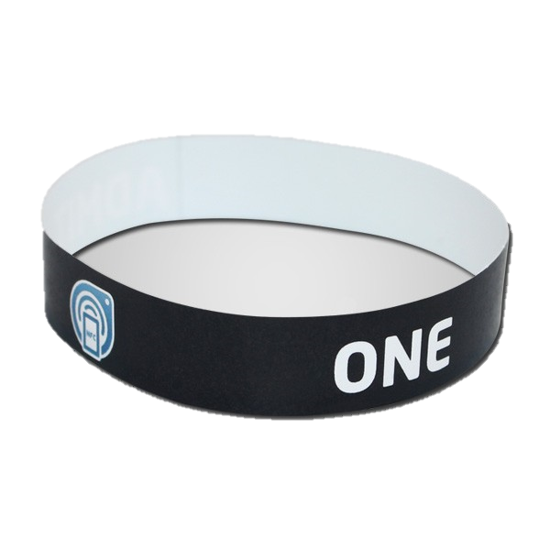
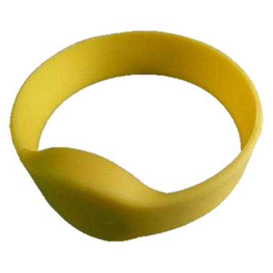
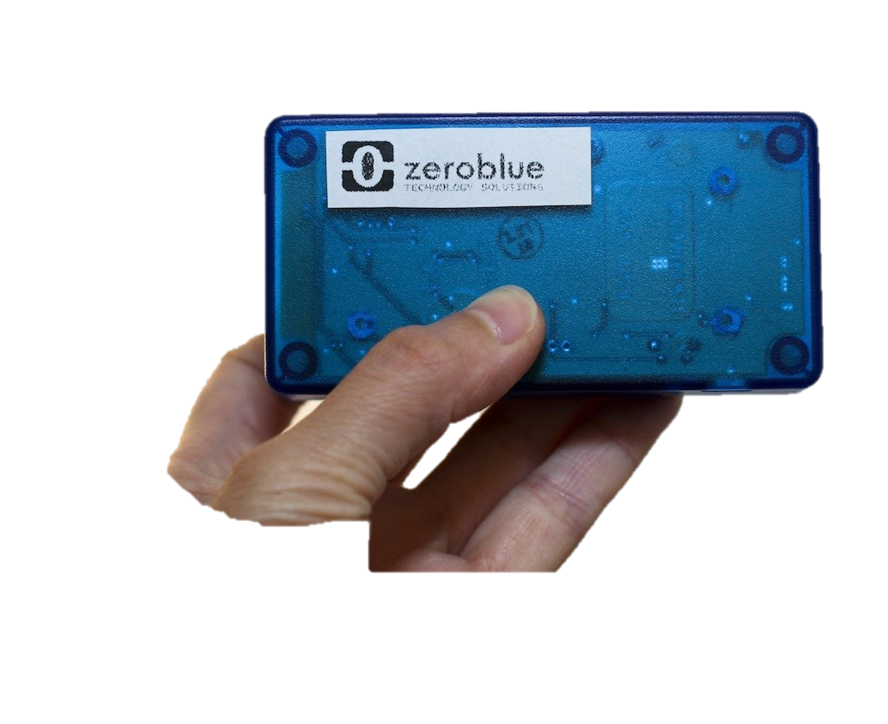
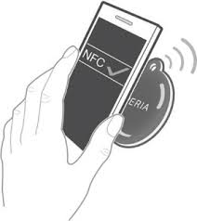
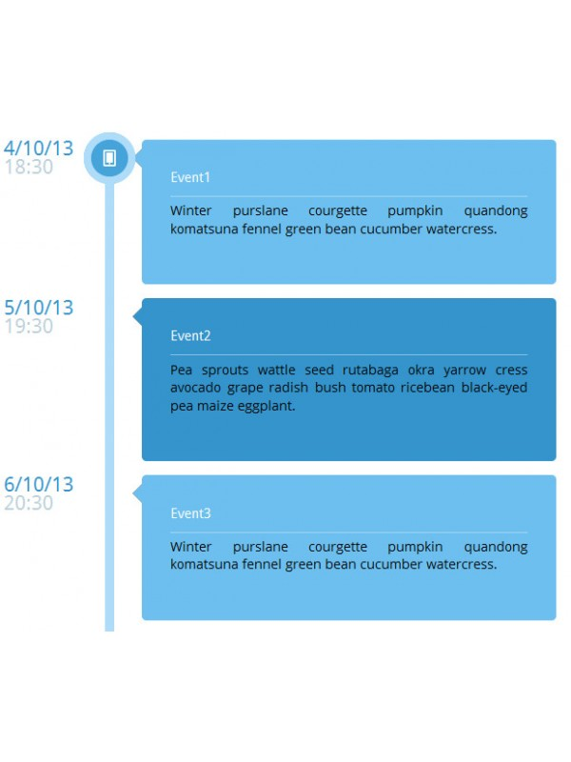
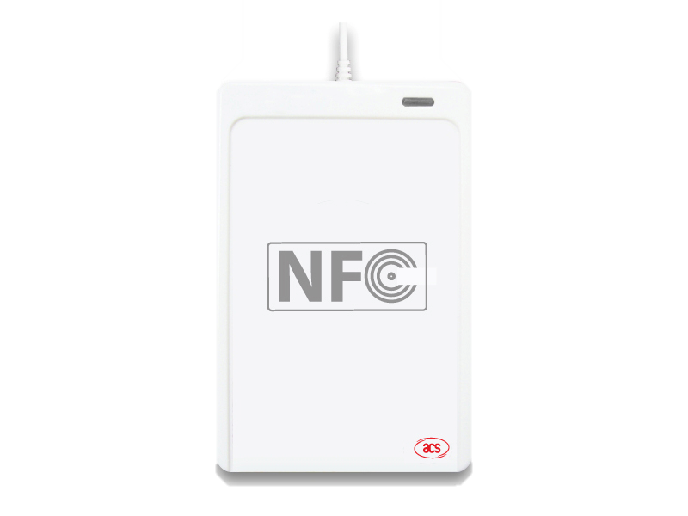
Solution Covers
HOW
Each visitor to these places will be issued a rubber/plastic NFC band which can sustain cruel weather conditions for at least for a month at a cost to user.
If user returns at the end of the journey, part of the amount will be given back
At each identified important places along the journey, users have to go through the Checkpoint to scan their tags which can be handled by volunteers with phones or NFC readers. No user information is visible to these volunteers
Rescue workers and medical units can have phones with apps and devices that can scan the same tags and get more information about the users in distress
Doctors with phone/devices will have access to medical history of the person provided at the time of registration to treat him/her better
Relatives of user can track by either SMS triggered at each checkpoint or can check portal which has logs of where all the user have been.

Slide 5
Costs
Tags cost Rs.35-70 ( few cents to $1 depending on durability)
Cheap readers without display cost Rs.2500 ($45)
User Registration volunteers, Rescue workers/Medical Unit/Doctors can user Android Phones/Windows Phones by downloading the app
Users pay small amount (Rs.50) for each tag. If user returns the tags in reusable condition, can get back part of the money
User can register for SMS package that sends a message to emergency contact’s phone when user crosses any checkpoint, for a small fee (Rs.25)
Cost effective solution from day one of implementation and break even within months if visitor inflow is huge

Slide 6
Code
https://github.com/code-for-india/weareready Contains
SQL Server Script
Demo SQL server is hosted in appharbor
REST API Server [ASP.Net MVC5 WebAPI2]
Demo Application is hosted at http://weareready.apphb.com/Help
Android application
Code ready to build in Eclipse
Login as ‘reg1’ (for user registration), ‘cp1’, ‘cp2’ (for checkpoint volunteer), ‘res’ (for rescue professionals), ‘air’ ( for ambulance/airlifters), ‘doc’ ( for doctors). Password for all users is ‘pass’

Slide 7
Next Steps
Internationalization
More platforms like WP8, Blackberry, Firefox OS, Tizen etc
UI for admin

Slide 8
Thanks
In case of issues, please contact
pooran@live.com
+919886701028

